Slide 1
CPSC 4430/5440: Machine Learning LessonD06(a): Recurrent Neural Networks
Yu Liang
Based on Allan, Andrej Karpathy, Fei-Fei Li, Justin Johnson

Slide 2
Outline
Summary of CNN
Motivation of RNN
Backward Propagation of RNN
Representative Applications of RNN

Slide 3
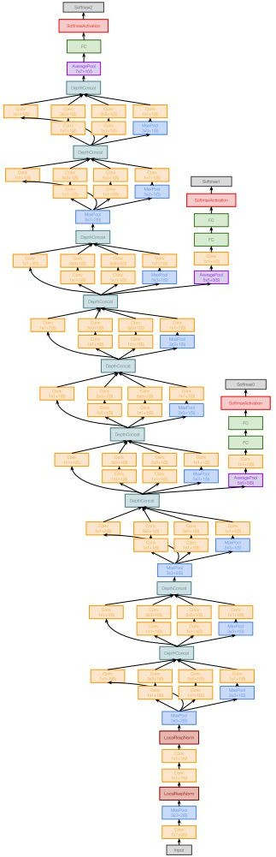
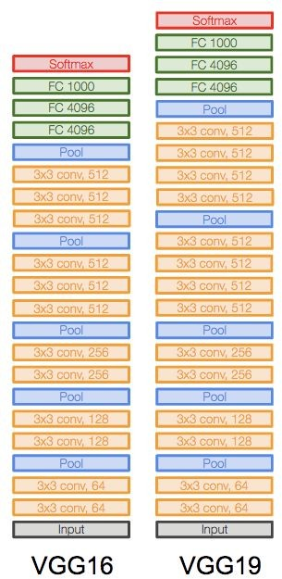
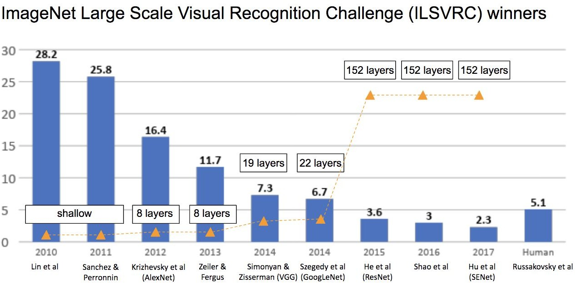
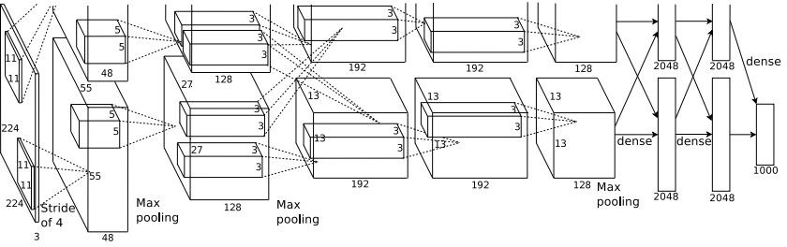
Last Time: CNN Architectures
GoogLeNet
AlexNet
Fei-Fei Li & Justin Johnson & Serena Yeung
3

Slide 4
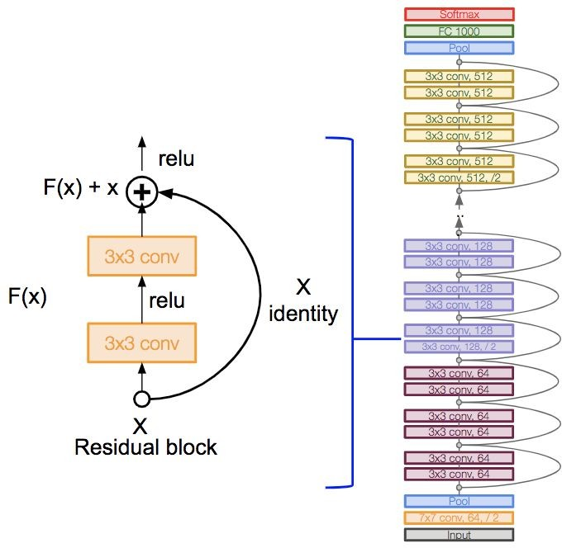
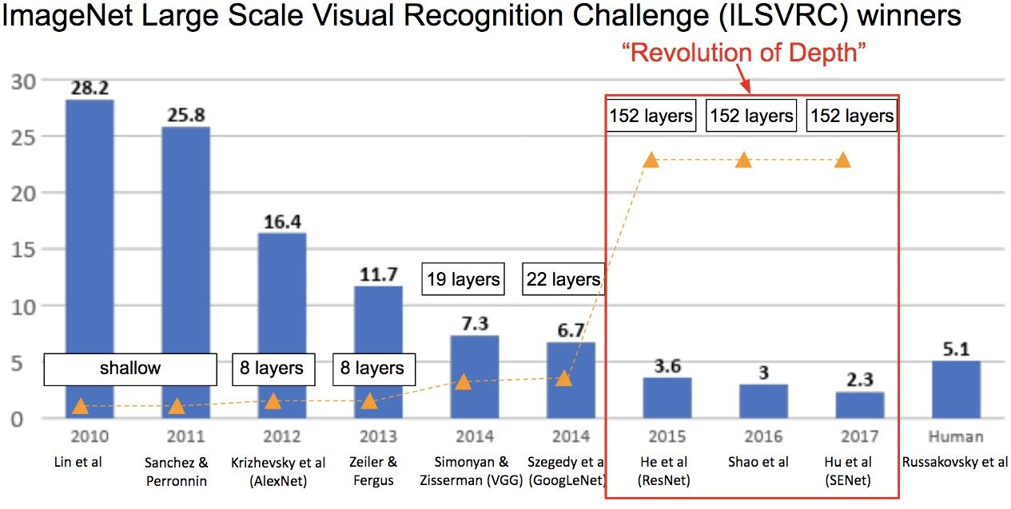
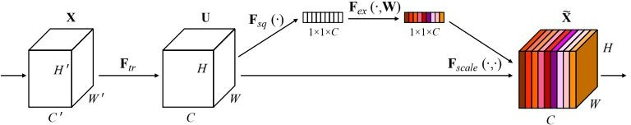
Last Time: CNN Architectures
ResNet
SENet
Fei-Fei Li & Justin Johnson & Serena Yeung
4

Slide 5
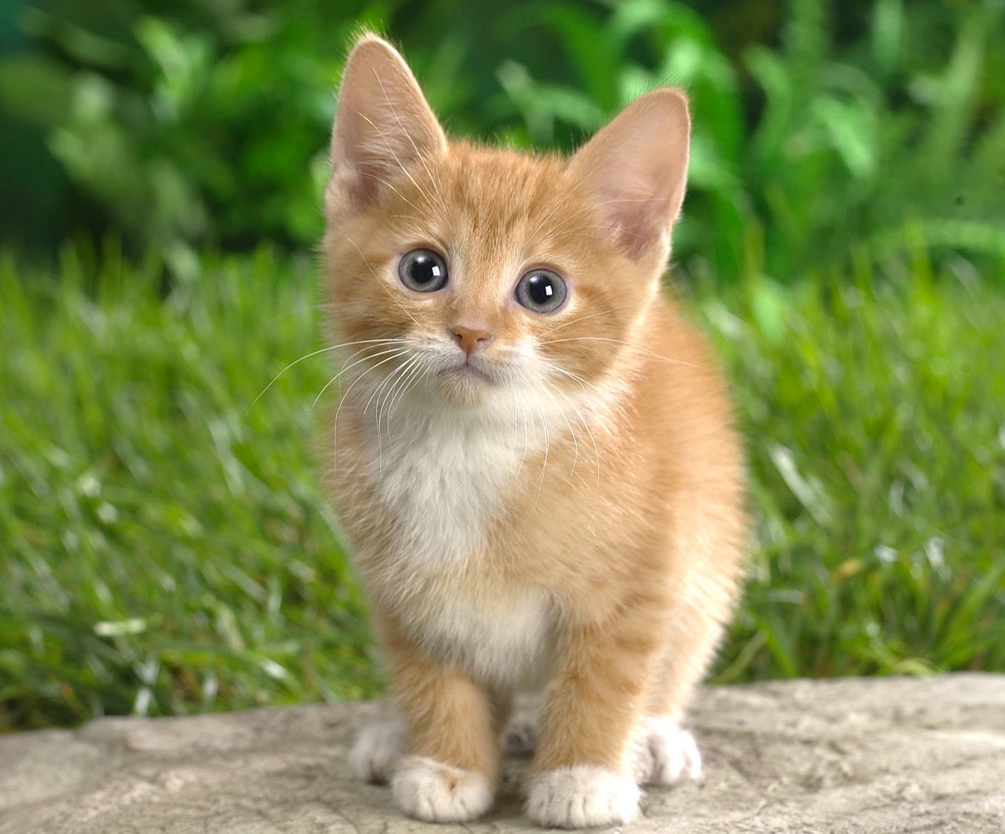
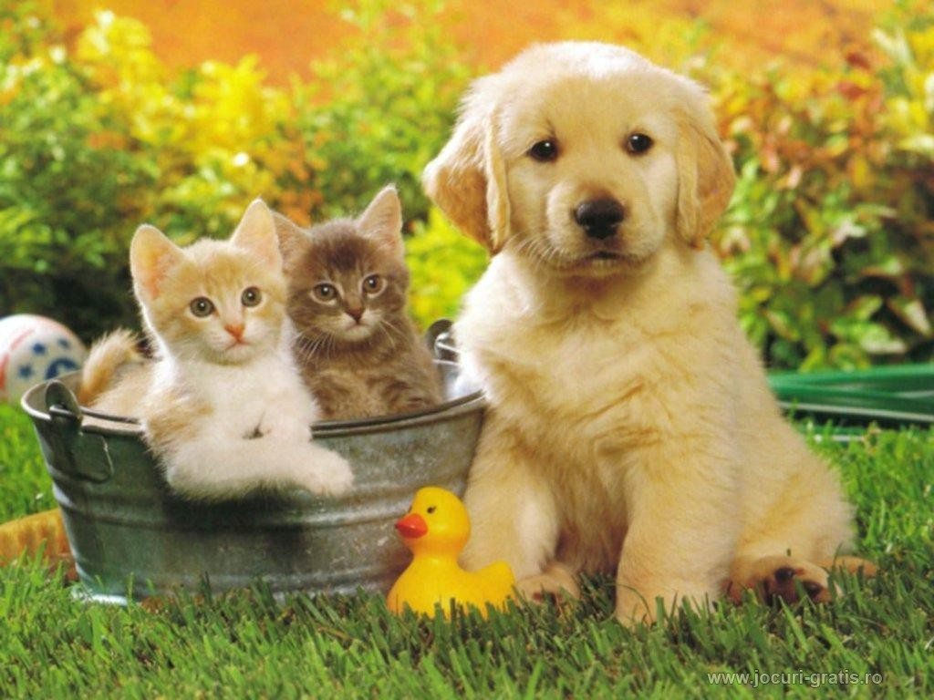
Review of Last time: Applications of CNN
Classification
Classification + Localization
Object Detection
Instance Segmentation
CAT
CAT
CAT, DOG, DUCK
CAT, DOG, DUCK
Single object
Multiple objects

Slide 6
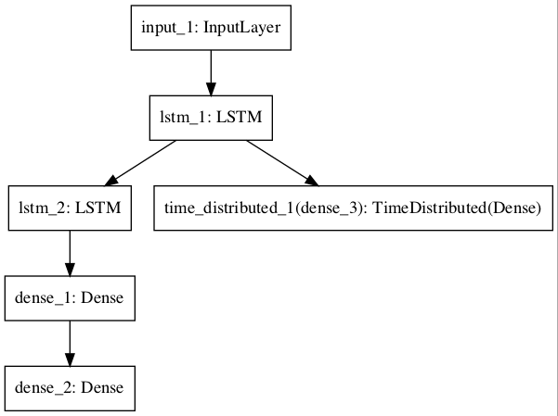
Review of Last time: Keras Functional Models
# Multiple Outputs
from keras.utils import plot_model
from keras.models import Model
from keras.layers import Input
from keras.layers import Dense
from keras.layers.recurrent import LSTM
from keras.layers.wrappers import TimeDistributed
# input layer
visible = Input(shape=(100,1))
# feature extraction
extract = LSTM(10, return_sequences=True)(visible)
# classification output
class11 = LSTM(10)(extract)
class12 = Dense(10, activation='relu')(class11)
output1 = Dense(1, activation='sigmoid')(class12)
# sequence output
output2 = TimeDistributed(Dense(1, activation='linear'))(extract)
# output
model = Model(inputs=visible, outputs=[output1, output2])
# summarize layers
print(model.summary())
# plot graph
plot_model(model, to_file='multiple_outputs.png')
visible
extract
output2
output1
Sequential Model is not as flexible

Slide 7
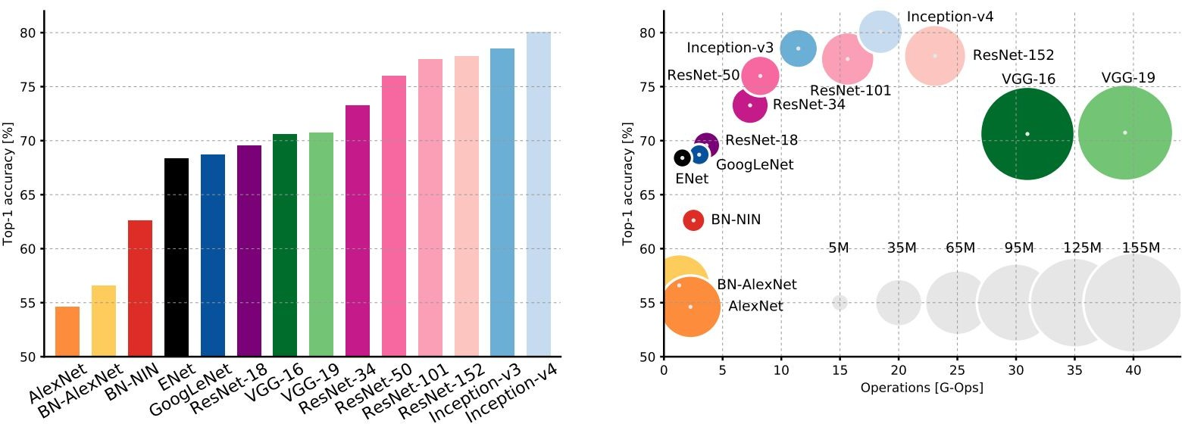
Comparing complexity of Various CNN Architecture...
An Analysis of Deep Neural Network Models for Practical Applications, 2017.
Figures copyright Alfredo Canziani, Adam Paszke, Eugenio Culurciello, 2017. Reproduced with permission.
Fei-Fei Li & Justin Johnson & Serena Yeung
6
Fei-Fei Li & Justin Johnson & Serena Yeung Lecture 10 - May 2, 2019

Slide 8
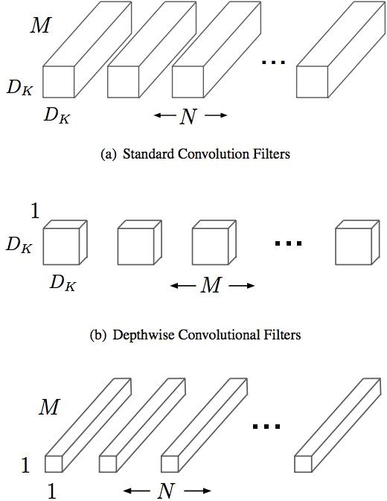
Efficient networks...
MobileNets: Efficient Convolutional Neural Networks for Mobile Applications
[Howard et al. 2017]
Depthwise separable convolutions replace standard convolutions by factorizing them into a depthwise convolution and a 1x1 convolution that is much more efficient
Much more efficient, with little loss in accuracy
Follow-up MobileNetV2 work in 2018 (Sandler et al.)
Other works in this space e.g. ShuffleNet (Zhang et al. 2017)
Fei-Fei Li & Justin Johnson & Serena Yeung
Fei-Fei Li & Justin Johnson & Serena Yeung Lecture 10 - May 2, 2019

Slide 9
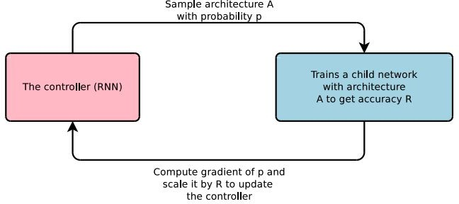
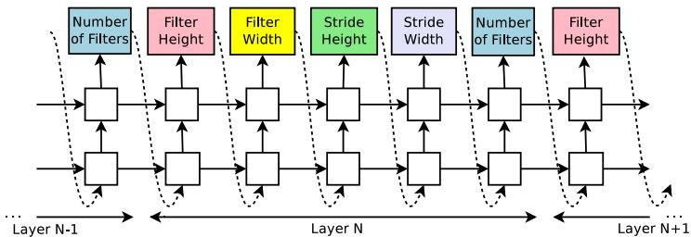
Meta-learning: Learning to learn network architectures...
Neural Architecture Search with Reinforcement Learning (NAS)
[Zoph et al. 2016]
“Controller” network that learns to design a good network architecture (output a string corresponding to network design)
Iterate:
Sample an architecture from search space
Train the architecture to get a “reward” R corresponding to accuracy
Compute gradient of sample probability, and scale by R to perform controller parameter update (i.e. increase likelihood of good architecture being sampled, decrease likelihood of bad architecture)
9

Slide 10
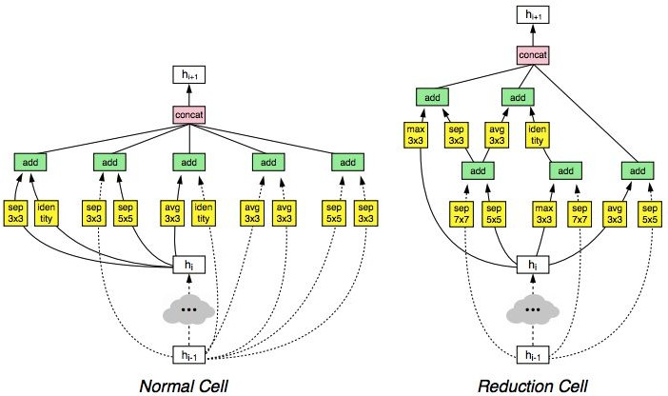
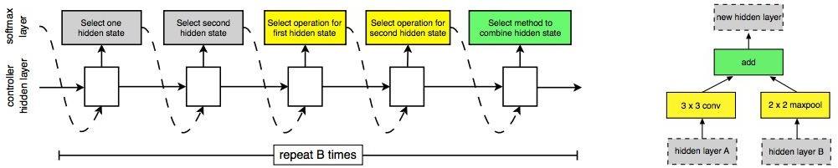
Meta-learning: Learning to learn network architectures... Learning Transferable Architectures for Scalable Image Recognition
[Zoph et al. 2017]
Applying neural architecture search (NAS) to a large dataset like ImageNet is expensive
Design a search space of building blocks (“cells”) that can be flexibly stacked
NASNet: Use NAS to find best cell structure on smaller CIFAR-10 dataset, then transfer architecture to ImageNet
Many follow-up works in this space e.g. AmoebaNet (Real et al. 2019) and ENAS (Pham, Guan et al. 2018)
Fei-Fei Li & Justin Johnson & Serena Yeung
10

Slide 11
Today: Recurrent Neural Networks
Fei-Fei Li & Justin Johnson & Serena Yeung
11

Slide 12

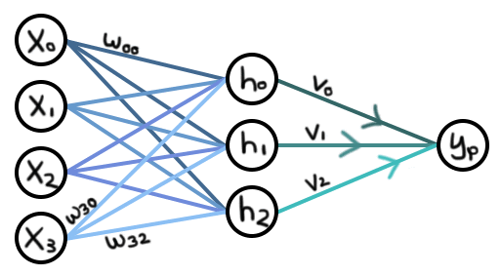
Recurrent Networks offer a lot of flexibility:
Vanilla Neural Networks

Slide 13
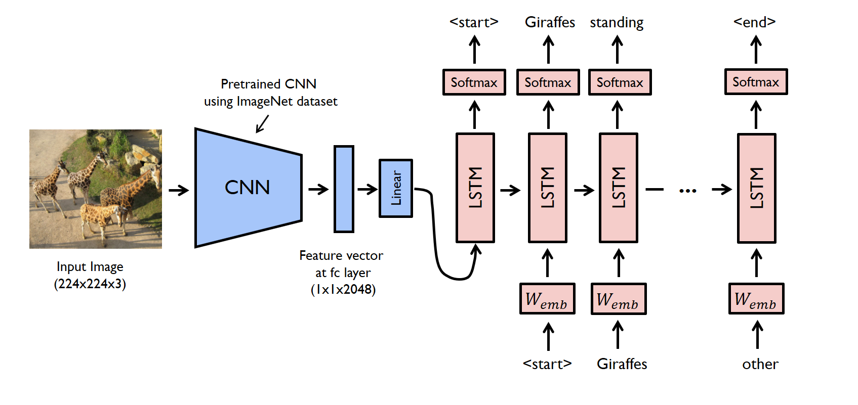
Recurrent Networks offer a lot of flexibility:
e.g. Image Captioning
image -> sequence of words

Slide 14
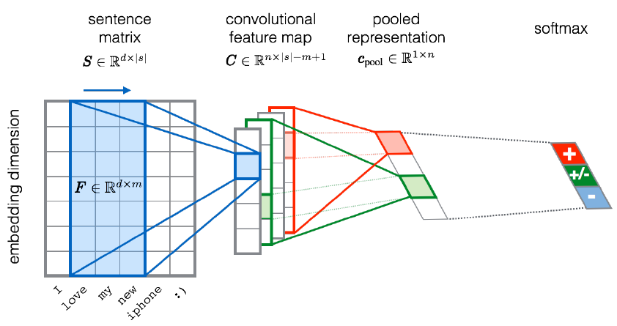
Recurrent Networks offer a lot of flexibility:
e.g. Sentiment Classification sequence of words -> sentiment

Slide 15
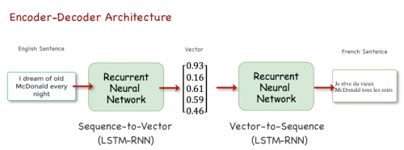
Recurrent Networks offer a lot of flexibility:
e.g. Machine Translation: seq of words -> seq of words
Latent vector

Slide 16
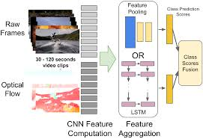
Recurrent Networks offer a lot of flexibility:
e.g. Video classification on frame level

Slide 17
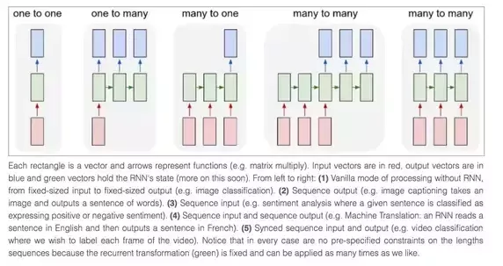
Recurrent Networks offer a lot of flexibility

Slide 18
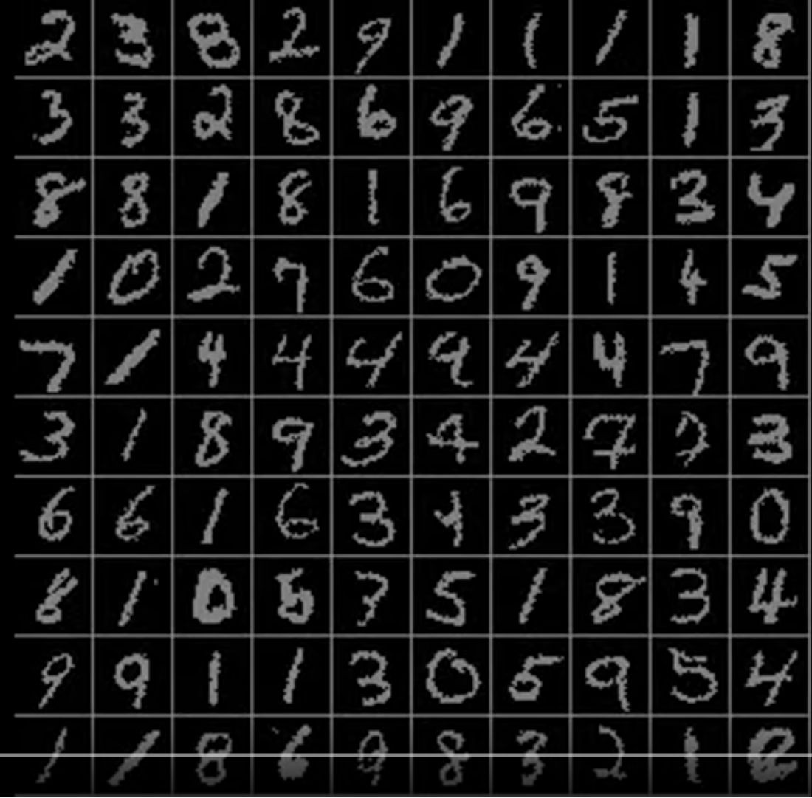
Sequential Processing of Non-Sequence Data
Classify images by taking a series of “glimpses”
Ba, Mnih, and Kavukcuoglu, “Multiple Object Recognition with Visual Attention”, ICLR 2015. Gregor et al, “DRAW: A Recurrent Neural Network For Image Generation”, ICML 2015
Figure copyright Karol Gregor, Ivo Danihelka, Alex Graves, Danilo Jimenez Rezende, and Daan Wierstra, 2015. Reproduced with permission.
Fei-Fei Li & Justin Johnson & Serena Yeung
18

Slide 19
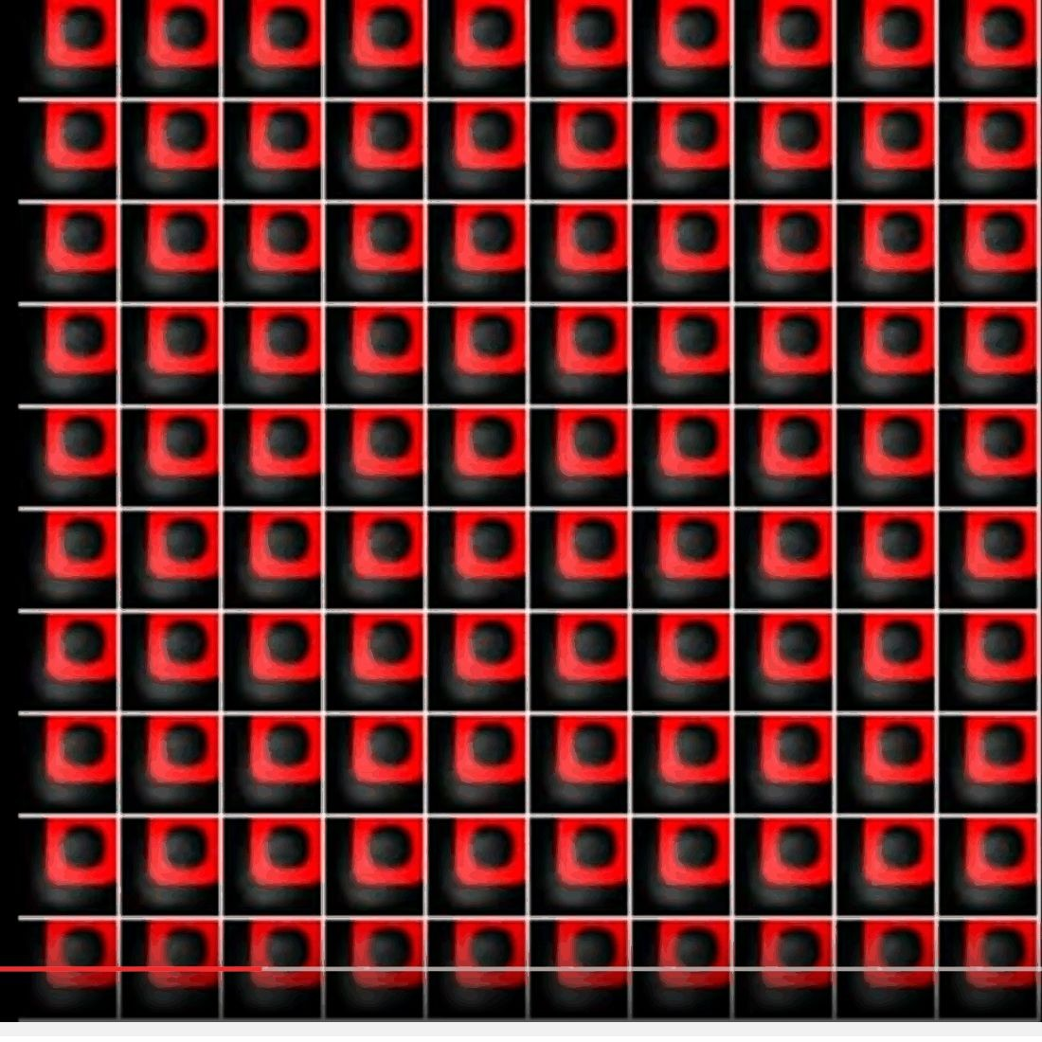
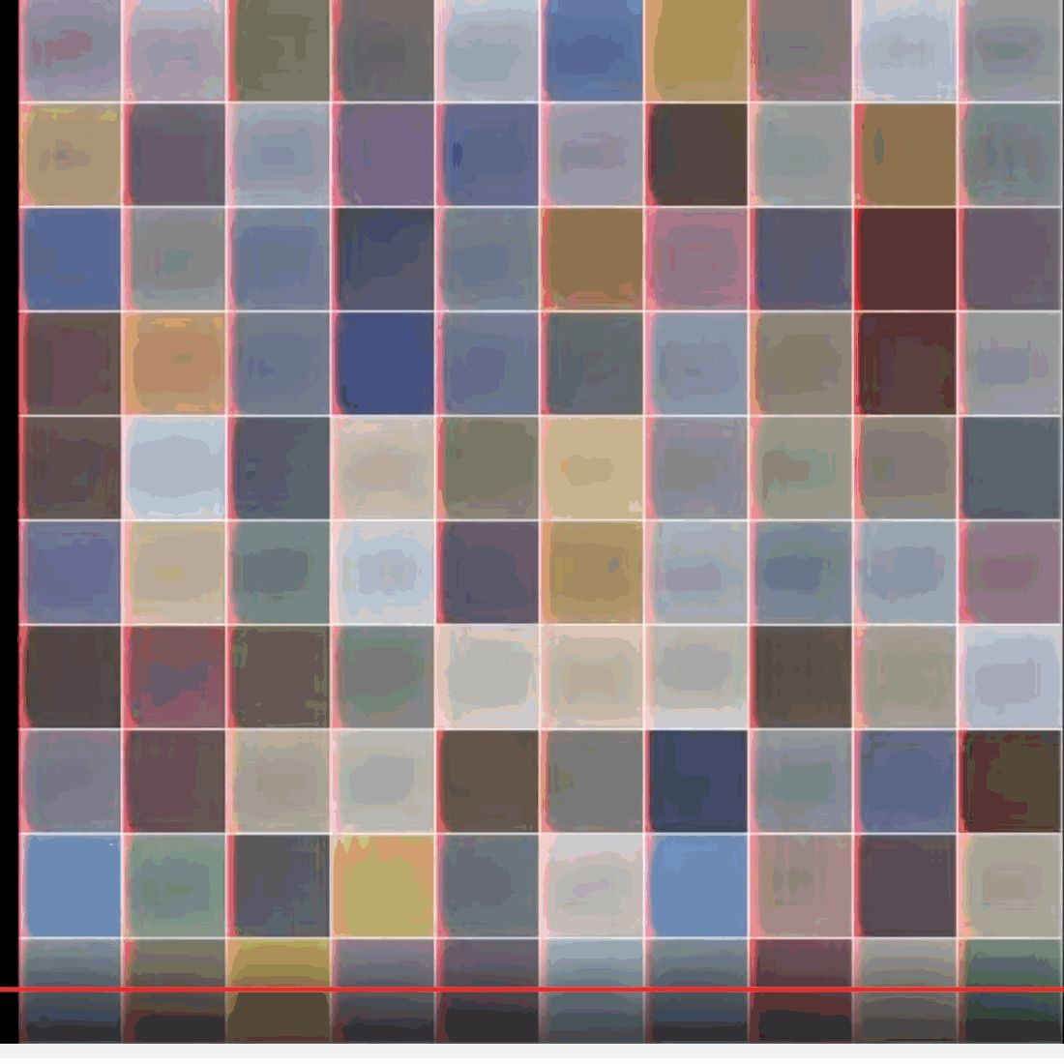
Sequential Processing of Non-Sequence Data
Generate images one piece at a time!
Gregor et al, “DRAW: A Recurrent Neural Network For Image Generation”, ICML 2015
Figure copyright Karol Gregor, Ivo Danihelka, Alex Graves, Danilo Jimenez Rezende, and Daan Wierstra, 2015. Reproduced with permission.
Fei-Fei Li & Justin Johnson & Serena Yeung
17

Slide 20
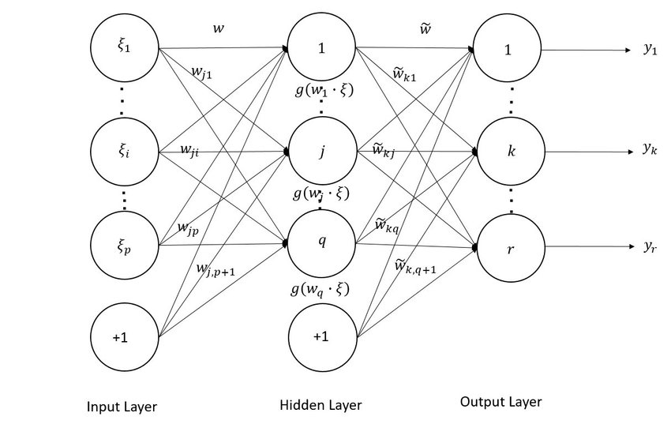
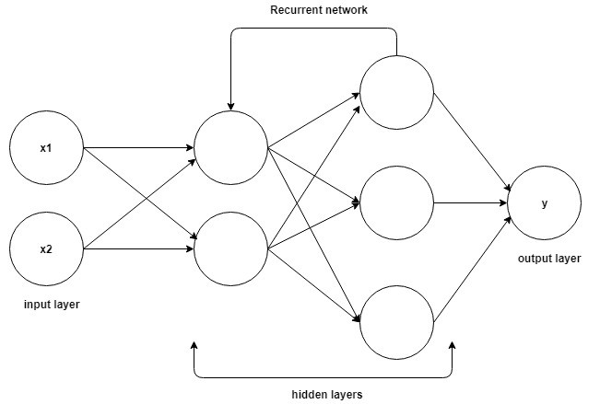
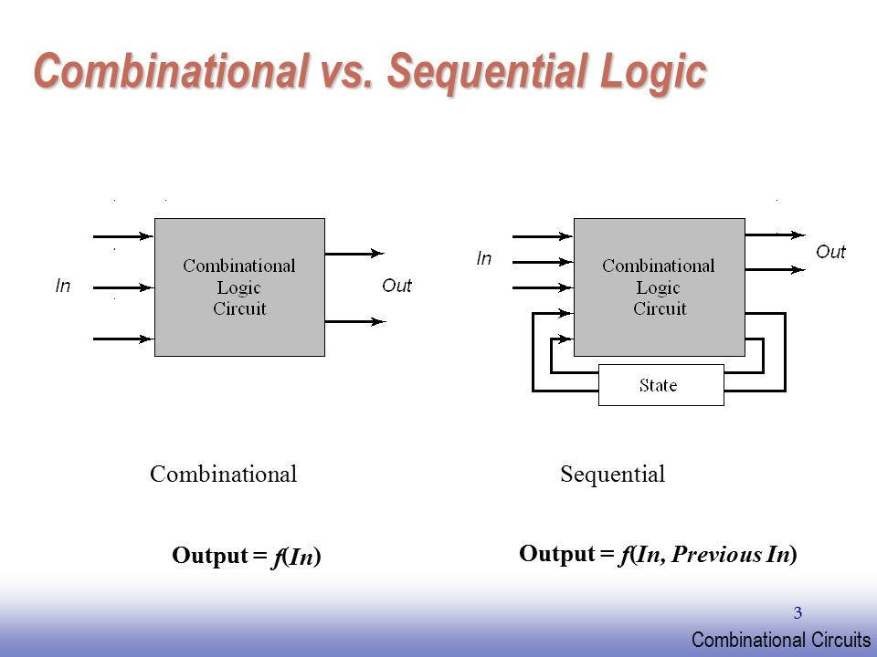
Feed-forward vs Recurrent NN
Feed-forward NN
Recurrent NN

Slide 21
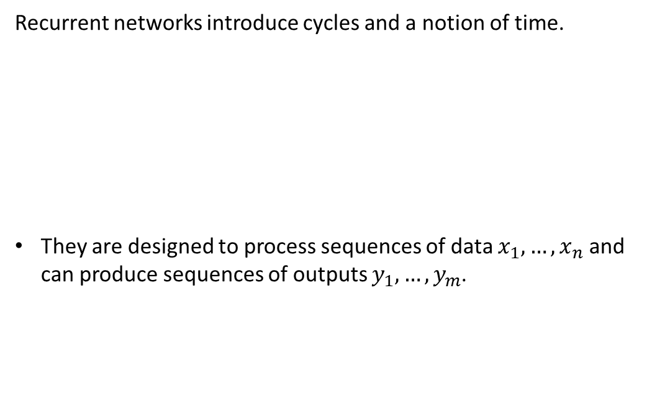
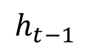
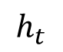
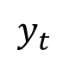
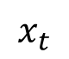
Functional Unit of Recurrent Neural Networks (RNNs)
Recurrent networks introduce cycles and a notion of time.
They are designed to process sequences of data $x_{1},…,x_{n}$ and can produce sequences of outputs $y_{1},…,y_{m}$.
$$x_{t}$$
$$y_{t}$$
$$h_{t−1}$$
$$h_{t}$$
One-step delay

Slide 22
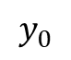
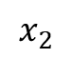
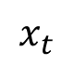
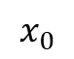
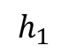
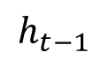
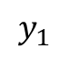
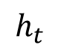
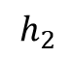
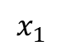
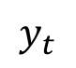
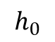
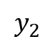
Computational Graph: Unrolling RNNs
RNNs can be unrolled across multiple time steps.
This produces a DAG which supports backpropagation.
But its size depends on the input sequence length.
$$x_{t}$$
$$y_{t}$$
$$y_{0}$$
$$x_{0}$$
$$h_{t−1}$$
$$h_{t}$$
$$h_{0}$$
$$y_{1}$$
One-step delay
$$x_{1}$$
$$h_{1}$$
$$y_{2}$$
$$x_{2}$$
$$h_{2}$$

Slide 23
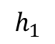
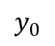
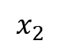
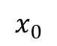














Unrolling RNNs
In previous discussion:
Usually drawn horizontally:
$$y_{0}$$
$$x_{0}$$
$$h_{0}$$
$$y_{0}$$
$$y_{1}$$
$$y_{2}$$
$$y_{1}$$
$$x_{1}$$
$$h_{0}$$
$$h_{1}$$
$$h_{2}$$
$$h_{1}$$
$$y_{2}$$
$$x_{0}$$
$$x_{1}$$
$$x_{2}$$
$$x_{2}$$
$$h_{2}$$

Slide 24


















RNN structure
Often layers are stacked vertically (deep RNNs):
$$y_{10}$$
$$y_{11}$$
$$y_{12}$$
$$h_{10}$$
$$h_{11}$$
$$h_{12}$$
Same parameters at this level
$$x_{00}$$
$$x_{01}$$
$$x_{02}$$
≠
Abstraction
Higher level features
$$y_{00}$$
$$y_{01}$$
$$y_{02}$$
$$h_{00}$$
$$h_{01}$$
$$h_{02}$$
Same parameters at this level
$$x_{0}$$
$$x_{1}$$
$$x_{2}$$
Time

Slide 25
RNN structure
Backprop still works:
$$y_{10}$$
$$y_{11}$$
$$y_{12}$$
$$h_{10}$$
$$h_{11}$$
$$h_{12}$$
$$x_{00}$$
$$x_{01}$$
$$x_{02}$$
Activations
Abstraction
Higher level features
$$y_{00}$$
$$y_{01}$$
$$y_{02}$$
$$h_{00}$$
$$h_{01}$$
$$h_{02}$$
$$x_{0}$$
$$x_{1}$$
$$x_{2}$$
Time

Slide 26
RNN structure
Backprop still works:
$$y_{10}$$
$$y_{11}$$
$$y_{12}$$
$$h_{10}$$
$$h_{11}$$
$$h_{12}$$
$$x_{00}$$
$$x_{01}$$
$$x_{02}$$
Activations
Abstraction
Higher level features
$$y_{00}$$
$$y_{01}$$
$$y_{02}$$
$$h_{00}$$
$$h_{01}$$
$$h_{02}$$
$$x_{0}$$
$$x_{1}$$
$$x_{2}$$
Time

Slide 27
RNN structure
Backprop still works:
$$y_{10}$$
$$y_{11}$$
$$y_{12}$$
$$h_{10}$$
$$h_{11}$$
$$h_{12}$$
$$x_{00}$$
$$x_{01}$$
$$x_{02}$$
Activations
Abstraction
Higher level features
$$y_{00}$$
$$y_{01}$$
$$y_{02}$$
$$h_{00}$$
$$h_{01}$$
$$h_{02}$$
$$x_{0}$$
$$x_{1}$$
$$x_{2}$$
Time

Slide 28
RNN structure
Backprop still works:
$$y_{10}$$
$$y_{11}$$
$$y_{12}$$
$$h_{10}$$
$$h_{11}$$
$$h_{12}$$
$$x_{00}$$
$$x_{01}$$
$$x_{02}$$
Activations
Abstraction
Higher level features
$$y_{00}$$
$$y_{01}$$
$$y_{02}$$
$$h_{00}$$
$$h_{01}$$
$$h_{02}$$
$$x_{0}$$
$$x_{1}$$
$$x_{2}$$
Time

Slide 29
RNN structure
Backprop still works:
$$y_{10}$$
$$y_{11}$$
$$y_{12}$$
$$h_{10}$$
$$h_{11}$$
$$h_{12}$$
$$x_{00}$$
$$x_{01}$$
$$x_{02}$$
Activations
Abstraction
Higher level features
$$y_{00}$$
$$y_{01}$$
$$y_{02}$$
$$h_{00}$$
$$h_{01}$$
$$h_{02}$$
$$x_{0}$$
$$x_{1}$$
$$x_{2}$$
Time

Slide 30
RNN structure
Backprop still works:
$$y_{10}$$
$$y_{11}$$
$$y_{12}$$
$$h_{10}$$
$$h_{11}$$
$$h_{12}$$
$$x_{00}$$
$$x_{01}$$
$$x_{02}$$
Activations
Abstraction
Higher level features
$$y_{00}$$
$$y_{01}$$
$$y_{02}$$
$$h_{00}$$
$$h_{01}$$
$$h_{02}$$
$$x_{0}$$
$$x_{1}$$
$$x_{2}$$
Time

Slide 31
RNN structure
Backprop still works:
$$y_{10}$$
$$y_{11}$$
$$y_{12}$$
$$h_{10}$$
$$h_{11}$$
$$h_{12}$$
$$x_{00}$$
$$x_{01}$$
$$x_{02}$$
Activations
Abstraction
Higher level features
$$y_{00}$$
$$y_{01}$$
$$y_{02}$$
$$h_{00}$$
$$h_{01}$$
$$h_{02}$$
$$x_{0}$$
$$x_{1}$$
$$x_{2}$$
Time

Slide 32
RNN structure
Backprop still works:
$$y_{10}$$
$$y_{11}$$
$$y_{12}$$
$$h_{10}$$
$$h_{11}$$
$$h_{12}$$
$$x_{00}$$
$$x_{01}$$
$$x_{02}$$
Gradients
Abstraction
Higher level features
$$y_{00}$$
$$y_{01}$$
$$y_{02}$$
$$h_{00}$$
$$h_{01}$$
$$h_{02}$$
$$x_{0}$$
$$x_{1}$$
$$x_{2}$$
Time

Slide 33
RNN structure
Backprop still works:
$$y_{10}$$
$$y_{11}$$
$$y_{12}$$
$$h_{10}$$
$$h_{11}$$
$$h_{12}$$
$$x_{00}$$
$$x_{01}$$
$$x_{02}$$
Gradients
Abstraction
Higher level features
$$y_{00}$$
$$y_{01}$$
$$y_{02}$$
$$h_{00}$$
$$h_{01}$$
$$h_{02}$$
$$x_{0}$$
$$x_{1}$$
$$x_{2}$$
Time

Slide 34
RNN structure
Backprop still works:
$$y_{10}$$
$$y_{11}$$
$$y_{12}$$
$$h_{10}$$
$$h_{11}$$
$$h_{12}$$
$$x_{00}$$
$$x_{01}$$
$$x_{02}$$
Gradients
Abstraction
Higher level features
$$y_{00}$$
$$y_{01}$$
$$y_{02}$$
$$h_{00}$$
$$h_{01}$$
$$h_{02}$$
$$x_{0}$$
$$x_{1}$$
$$x_{2}$$
Time

Slide 35
RNN structure
Backprop still works:
$$y_{10}$$
$$y_{11}$$
$$y_{12}$$
$$h_{10}$$
$$h_{11}$$
$$h_{12}$$
$$x_{00}$$
$$x_{01}$$
$$x_{02}$$
Gradients
Abstraction
Higher level features
$$y_{00}$$
$$y_{01}$$
$$y_{02}$$
$$h_{00}$$
$$h_{01}$$
$$h_{02}$$
$$x_{0}$$
$$x_{1}$$
$$x_{2}$$
Time

Slide 36
RNN structure
Backprop still works:
$$y_{10}$$
$$y_{11}$$
$$y_{12}$$
$$h_{10}$$
$$h_{11}$$
$$h_{12}$$
$$x_{00}$$
$$x_{01}$$
$$x_{02}$$
Gradients
Abstraction
Higher level features
$$y_{00}$$
$$y_{01}$$
$$y_{02}$$
$$h_{00}$$
$$h_{01}$$
$$h_{02}$$
$$x_{0}$$
$$x_{1}$$
$$x_{2}$$
Time

Slide 37
RNN structure
Backprop still works:
$$y_{10}$$
$$y_{11}$$
$$y_{12}$$
$$h_{10}$$
$$h_{11}$$
$$h_{12}$$
$$x_{00}$$
$$x_{01}$$
$$x_{02}$$
Gradients
Abstraction
Higher level features
$$y_{00}$$
$$y_{01}$$
$$y_{02}$$
$$h_{00}$$
$$h_{01}$$
$$h_{02}$$
$$x_{0}$$
$$x_{1}$$
$$x_{2}$$
Time

Slide 38
RNN structure
Backprop still works:
$$y_{10}$$
$$y_{11}$$
$$y_{12}$$
$$h_{10}$$
$$h_{11}$$
$$h_{12}$$
$$x_{00}$$
$$x_{01}$$
$$x_{02}$$
Gradients
Abstraction
Higher level features
$$y_{00}$$
$$y_{01}$$
$$y_{02}$$
$$h_{00}$$
$$h_{01}$$
$$h_{02}$$
$$x_{0}$$
$$x_{1}$$
$$x_{2}$$
Time

Slide 39
Recurrent Neural Network
y
RNN
x
Fei-Fei Li & Justin Johnson & Serena Yeung
Fei-Fei Li & Justin Johnson & Serena Yeung Lecture 10 - May 2, 2019

Slide 40
Recurrent Neural Network
y
Key idea: RNNs have an “internal state” that is updated as a sequence is processed
RNN
x
Fei-Fei Li & Justin Johnson & Serena Yeung
Fei-Fei Li & Justin Johnson & Serena Yeung Lecture 10 - May 2, 2019

Slide 41

Recurrent Neural Network
We can process a sequence of vectors x by applying a recurrence formula at every time step:
y
RNN
new state old state input vector at
some time step
x
some function
with parameters W
Fei-Fei Li & Justin Johnson & Serena Yeung
Fei-Fei Li & Justin Johnson & Serena Yeung Lecture 10 - May 2, 2019

Slide 42
Recurrent Neural Network
We can process a sequence of vectors x by applying a recurrence formula at every time step:
y
RNN
x
Notice: the same function and the same set of parameters are used at every time step.
Fei-Fei Li & Justin Johnson & Serena Yeung
Fei-Fei Li & Justin Johnson & Serena Yeung Lecture 10 - May 2, 2019

Slide 43

(Simple) Recurrent Neural Network
The state consists of a single “hidden” vector h:
y
RNN
x
Sometimes called a “Vanilla RNN” or an “Elman RNN” after Prof. Jeffrey Elman
Fei-Fei Li & Justin Johnson & Serena Yeung
Fei-Fei Li & Justin Johnson & Serena Yeung Lecture 10 - May 2, 2019

Slide 44
RNN: Computational Graph
h₀
h₁
f_{W}
x₁
Fei-Fei Li & Justin Johnson & Serena Yeung
Fei-Fei Li & Justin Johnson & Serena Yeung Lecture 10 - May 2, 2019

Slide 45
RNN: Computational Graph
h₀
h₁
h₂
f_{W}
f_{W}
x₁
x₂
Fei-Fei Li & Justin Johnson & Serena Yeung
Fei-Fei Li & Justin Johnson & Serena Yeung Lecture 10 - May 2, 2019

Slide 46
RNN: Computational Graph
h₀
h₁
h₂
h₃
…
h_{T}
f_{W}
f_{W}
f_{W}
x₁
x₂
x₃
Fei-Fei Li & Justin Johnson & Serena Yeung
Fei-Fei Li & Justin Johnson & Serena Yeung Lecture 10 - May 2, 2019

Slide 47
RNN: Computational Graph
Re-use the same weight matrix at every time-step
h₂
h₃
…
h_{T}
h₀
f_{W}
h₁
f_{W}
f_{W}
x₁
x₂
x₃
W
Fei-Fei Li & Justin Johnson & Serena Yeung
Fei-Fei Li & Justin Johnson & Serena Yeung Lecture 10 - May 2, 2019

Slide 48
RNN: Computational Graph: Many to Many
y₁
y₂
y₃
y_{T}
h₂
h₃
…
h_{T}
h₀
f_{W}
h₁
f_{W}
f_{W}
x₁
x₂
x₃
W
Fei-Fei Li & Justin Johnson & Serena Yeung
Fei-Fei Li & Justin Johnson & Serena Yeung Lecture 10 - May 2, 2019

Slide 49
RNN: Computational Graph: Many to Many
y₁
y₂
y₃
y_{T}
L₁
L₂
L₃
L_{T}
h₂
h₃
…
h_{T}
h₀
f_{W}
h₁
f_{W}
f_{W}
x₁
x₂
x₃
W
Fei-Fei Li & Justin Johnson & Serena Yeung
Fei-Fei Li & Justin Johnson & Serena Yeung Lecture 10 - May 2, 2019

Slide 50
RNN: Computational Graph: Many to Many
L
y₁
y₂
y₃
y_{T}
L₁
L₂
L₃
L_{T}
h₂
h₃
…
h_{T}
h₀
f_{W}
h₁
f_{W}
f_{W}
x₁
x₂
x₃
W
Fei-Fei Li & Justin Johnson & Serena Yeung
Fei-Fei Li & Justin Johnson & Serena Yeung Lecture 10 - May 2, 2019

Slide 51
RNN: Computational Graph: Many to One
y
h₂
h₃
…
h_{T}
h₀
f_{W}
h₁
f_{W}
f_{W}
x₁
x₂
x₃
W
Fei-Fei Li & Justin Johnson & Serena Yeung
Fei-Fei Li & Justin Johnson & Serena Yeung Lecture 10 - May 2, 2019

Slide 52
RNN: Computational Graph: One to Many
y₁
y₂
y₃
y_{T}
h₂
h₃
…
h_{T}
h₀
f_{W}
h₁
f_{W}
f_{W}
x
W
Fei-Fei Li & Justin Johnson & Serena Yeung
Fei-Fei Li & Justin Johnson & Serena Yeung Lecture 10 - May 2, 2019

Slide 53
Sequence to Sequence: Many-to-one + one-to-many
Many to one: Encode input sequence in a single vector
h
0
f_{W}
h
1
f_{W}
h
2
f_{W}
h
3
…
h
T
x
1
x
2
x
3
W
1
Sutskever et al, “Sequence to Sequence Learning with Neural Networks”, NIPS 2014
Fei-Fei Li & Justin Johnson & Serena Yeung
Fei-Fei Li & Justin Johnson & Serena Yeung Lecture 10 - May 2, 2019

Slide 54
Sequence to Sequence: Many-to-one + one-to-many
One to many: Produce output sequence from single input vector
Many to one: Encode input
sequence in a single vector
y
1
y
2
h
0
f_{W}
h
1
f_{W}
h
2
f_{W}
h
3
…
h
T
h
1
h
2
…
f_{W}
f_{W}
f_{W}
x
1
x
2
x
3
W
W
1
2
Sutskever et al, “Sequence to Sequence Learning with Neural Networks”, NIPS 2014
Fei-Fei Li & Justin Johnson & Serena Yeung
Fei-Fei Li & Justin Johnson & Serena Yeung Lecture 10 - May 2, 2019

Slide 55
Application Examples of RNN
Character-level Language Model
Generate C Code
Searching for interpretable cells
Video Caption

Slide 56

Example: Character-level Language Model
Vocabulary: [h,e,l,o]
Example training sequence: “hello”
Fei-Fei Li & Justin Johnson & Serena Yeung
Fei-Fei Li & Justin Johnson & Serena Yeung Lecture 10 - May 2, 2019

Slide 57
Example: Character-level Language Model
Vocabulary: [h,e,l,o]
Example training sequence: “hello”
Fei-Fei Li & Justin Johnson & Serena Yeung
Fei-Fei Li & Justin Johnson & Serena Yeung Lecture 10 - May 2, 2019

Slide 58
Example: Character-level Language Model
Vocabulary: [h,e,l,o]
Example training sequence: “hello”
Fei-Fei Li & Justin Johnson & Serena Yeung
Fei-Fei Li & Justin Johnson & Serena Yeung Lecture 10 - May 2, 2019

Slide 59

Example: Character-level Language Model Sampling
“e”
“l”
.25
.20
.05
.50
“l” “o”
.11 .11
.17 .02
.68 .08
.03 .79
Sample
.03
.13
.00
.84
Softmax
Vocabulary: [h,e,l,o]
At test-time sample characters one at a time, feed back to model
Fei-Fei Li & Justin Johnson & Serena Yeung
Fei-Fei Li & Justin Johnson & Serena Yeung Lecture 10 - May 2, 2019

Slide 60
Example: Character-level Language Model Sampling
“e”
“l”
.25
.20
.05
.50
“l” “o”
.11 .11
.17 .02
.68 .08
.03 .79
Sample
.03
.13
.00
.84
Softmax
Vocabulary: [h,e,l,o]
At test-time sample characters one at a time, feed back to model
Fei-Fei Li & Justin Johnson & Serena Yeung
Fei-Fei Li & Justin Johnson & Serena Yeung Lecture 10 - May 2, 2019

Slide 61
Example: Character-level Language Model Sampling
“e”
“l”
“l” “o”
.11 .11
.17 .02
.68 .08
.03 .79
Sample
.03
.13
.00
.84
.25
.20
.05
.50
Softmax
Vocabulary: [h,e,l,o]
At test-time sample characters one at a time, feed back to model
Fei-Fei Li & Justin Johnson & Serena Yeung
Fei-Fei Li & Justin Johnson & Serena Yeung Lecture 10 - May 2, 2019

Slide 62
Example: Character-level Language Model Sampling
“e”
“l”
“l”
“o”
Sample
.03
.13
.00
.84
.25
.20
.05
.50
.11
.17
.68
.03
.11
.02
.08
.79
Softmax
Vocabulary: [h,e,l,o]
At test-time sample characters one at a time, feed back to model
Fei-Fei Li & Justin Johnson & Serena Yeung
Fei-Fei Li & Justin Johnson & Serena Yeung Lecture 10 - May 2, 2019

Slide 63


Backpropagation through time
Forward through entire sequence to compute loss, then backward through entire sequence to compute gradient
Loss
Fei-Fei Li & Justin Johnson & Serena Yeung
Fei-Fei Li & Justin Johnson & Serena Yeung Lecture 10 - May 2, 2019

Slide 64
Truncated Backpropagation through time
Loss
Run forward and backward through chunks of the sequence instead of whole sequence
Fei-Fei Li & Justin Johnson & Serena Yeung
Fei-Fei Li & Justin Johnson & Serena Yeung Lecture 10 - May 2, 2019

Slide 65
Truncated Backpropagation through time
Loss
Carry hidden states forward in time forever, but only backpropagate for some smaller number of steps
Fei-Fei Li & Justin Johnson & Serena Yeung
Fei-Fei Li & Justin Johnson & Serena Yeung Lecture 10 - May 2, 2019

Slide 66
Truncated Backpropagation through time
Loss
Fei-Fei Li & Justin Johnson & Serena Yeung
Fei-Fei Li & Justin Johnson & Serena Yeung Lecture 10 - May 2, 2019

Slide 67


min-char-rnn.py gist: 112 lines of Python
(https://gist.github.com/karpathy/d4dee 566867f8291f086)
Fei-Fei Li & Justin Johnson & Serena Yeung
Fei-Fei Li & Justin Johnson & Serena Yeung Lecture 10 - May 2, 2019

Slide 68


y
RNN
x
Fei-Fei Li & Justin Johnson & Serena Yeung
Fei-Fei Li & Justin Johnson & Serena Yeung Lecture 10 - May 2, 2019

Slide 69



at first:
train more
train more
train more
Fei-Fei Li & Justin Johnson & Serena Yeung
Fei-Fei Li & Justin Johnson & Serena Yeung Lecture 10 - May 2, 2019

Slide 70


Fei-Fei Li & Justin Johnson & Serena Yeung
Fei-Fei Li & Justin Johnson & Serena Yeung Lecture 10 - May 2, 2019

Slide 71

The Stacks Project: open source algebraic geometry textbook
Latex source
http://stacks.math.columbia.edu/
The stacks project is licensed under the GNU Free Documentation License
Fei-Fei Li & Justin Johnson & Serena Yeung
Fei-Fei Li & Justin Johnson & Serena Yeung Lecture 10 - May 2, 2019

Slide 72

Fei-Fei Li & Justin Johnson & Serena Yeung
Fei-Fei Li & Justin Johnson & Serena Yeung Lecture 10 - May 2, 2019

Slide 73

Fei-Fei Li & Justin Johnson & Serena Yeung
Fei-Fei Li & Justin Johnson & Serena Yeung Lecture 10 - May 2, 2019

Slide 74

Fei-Fei Li & Justin Johnson & Serena Yeung
Fei-Fei Li & Justin Johnson & Serena Yeung Lecture 10 - May 2, 2019

Slide 75

Generated C code
Fei-Fei Li & Justin Johnson & Serena Yeung
Fei-Fei Li & Justin Johnson & Serena Yeung Lecture 10 - May 2, 2019

Slide 76

Fei-Fei Li & Justin Johnson & Serena Yeung
Fei-Fei Li & Justin Johnson & Serena Yeung Lecture 10 - May 2, 2019

Slide 77

Fei-Fei Li & Justin Johnson & Serena Yeung
Fei-Fei Li & Justin Johnson & Serena Yeung Lecture 10 - May 2, 2019

Slide 78
Searching for interpretable cells
Karpathy, Johnson, and Fei-Fei: Visualizing and Understanding Recurrent Networks, ICLR Workshop 2016
Fei-Fei Li & Justin Johnson & Serena Yeung
Fei-Fei Li & Justin Johnson & Serena Yeung Lecture 10 - May 2, 2019

Slide 79

Searching for interpretable cells
Karpathy, Johnson, and Fei-Fei: Visualizing and Understanding Recurrent Networks, ICLR Workshop 2016
Figures copyright Karpathy, Johnson, and Fei-Fei, 2015; reproduced with permission
Fei-Fei Li & Justin Johnson & Serena Yeung
Fei-Fei Li & Justin Johnson & Serena Yeung Lecture 10 - May 2, 2019

Slide 80

Searching for interpretable cells
quote detection cell
Karpathy, Johnson, and Fei-Fei: Visualizing and Understanding Recurrent Networks, ICLR Workshop 2016
Figures copyright Karpathy, Johnson, and Fei-Fei, 2015; reproduced with permission
Fei-Fei Li & Justin Johnson & Serena Yeung
Fei-Fei Li & Justin Johnson & Serena Yeung Lecture 10 - May 2, 2019

Slide 81

Searching for interpretable cells
line length tracking cell
Karpathy, Johnson, and Fei-Fei: Visualizing and Understanding Recurrent Networks, ICLR Workshop 2016
Figures copyright Karpathy, Johnson, and Fei-Fei, 2015; reproduced with permission
Fei-Fei Li & Justin Johnson & Serena Yeung
Fei-Fei Li & Justin Johnson & Serena Yeung Lecture 10 - May 2, 2019

Slide 82

Searching for interpretable cells
if statement cell
Karpathy, Johnson, and Fei-Fei: Visualizing and Understanding Recurrent Networks, ICLR Workshop 2016
Figures copyright Karpathy, Johnson, and Fei-Fei, 2015; reproduced with permission
Fei-Fei Li & Justin Johnson & Serena Yeung
Fei-Fei Li & Justin Johnson & Serena Yeung Lecture 10 - May 2, 2019

Slide 83

Searching for interpretable cells
quote/comment cell
Karpathy, Johnson, and Fei-Fei: Visualizing and Understanding Recurrent Networks, ICLR Workshop 2016
Figures copyright Karpathy, Johnson, and Fei-Fei, 2015; reproduced with permission
Fei-Fei Li & Justin Johnson & Serena Yeung
Fei-Fei Li & Justin Johnson & Serena Yeung Lecture 10 - May 2, 2019

Slide 84

Searching for interpretable cells
code depth cell
Karpathy, Johnson, and Fei-Fei: Visualizing and Understanding Recurrent Networks, ICLR Workshop 2016
Figures copyright Karpathy, Johnson, and Fei-Fei, 2015; reproduced with permission
Fei-Fei Li & Justin Johnson & Serena Yeung
Fei-Fei Li & Justin Johnson & Serena Yeung Lecture 10 - May 2, 2019

Slide 85

Image Captioning
Figure from Karpathy et a, “Deep
Visual-Semantic Alignments for Generating Image Descriptions”, CVPR 2015; figure copyright IEEE, 2015.
Reproduced for educational purposes.
Explain Images with Multimodal Recurrent Neural Networks, Mao et al.
Deep Visual-Semantic Alignments for Generating Image Descriptions, Karpathy and Fei-Fei Show and Tell: A Neural Image Caption Generator, Vinyals et al.
Long-term Recurrent Convolutional Networks for Visual Recognition and Description, Donahue et al. Learning a Recurrent Visual Representation for Image Caption Generation, Chen and Zitnick
Fei-Fei Li & Justin Johnson & Serena Yeung
Fei-Fei Li & Justin Johnson & Serena Yeung Lecture 10 - May 2, 2019

Slide 86
Recurrent Neural Network
Convolutional Neural Network
Fei-Fei Li & Justin Johnson & Serena Yeung
Fei-Fei Li & Justin Johnson & Serena Yeung Lecture 10 - May 2, 2019

Slide 87

test image
This image is CC0 public domain
Fei-Fei Li & Justin Johnson & Serena Yeung
Lecture 10 -
May 2, 2019

Slide 88

test image
F
ei-Fei Li &
Justin Johnson & Serena Yeung
Lecture 10 -
May 2, 2019

Slide 89
test image

Slide 90
test image
x0
<START>

Slide 91

test image
y0
before:
h = tanh(Wxh * x + Whh * h)
h0
Wih
now:
h = tanh(Wxh * x + Whh * h + Wih * v)
x0
<STA RT>

Slide 92
test image
y0
h0
sample!
x0
<STA RT>
straw

Slide 93
test image
y0
y1
h0
h1
x0
<STA RT>
straw

Slide 94
test image
y0
y1
h0
h1
sample!
x0
<STA RT>
straw
hat

Slide 95
test image
y0
y1
y2
h0
h1
h2
x0
<STA RT>
straw
hat

Slide 96
test image
y0
y1
y2
sample
<END> token
=> finish.
h0
h1
h2
x0
<STA RT>
straw
hat

Slide 97








Image Captioning: Example Results
Captions generated using neuraltalk2 All images are CC0 Public domain:
cat suitcase, cat tree, dog, bear,
surfers, tennis, giraffe, motorcycle
A cat sitting on a suitcase on the floor
A cat is sitting on a tree branch
A dog is running in the grass with a frisbee
A white teddy bear sitting in the grass
Two people walking on the beach with surfboards
A tennis player in action on the court
Two giraffes standing in a grassy field
A man riding a dirt bike on a dirt track
Fei-Fei Li & Justin Johnson & Serena Yeung
Fei-Fei Li & Justin Johnson & Serena Yeung Lecture 10 - May 2, 2019

Slide 98





Image Captioning: Failure Cases
Captions generated using neuraltalk2 All images are CC0 Public domain: fur coat, handstand, spider web, baseball
A bird is perched on a tree branch
A woman is holding a cat in her hand
A man in a baseball uniform throwing a ball
A woman standing on a beach holding a surfboard
A person holding a computer mouse on a desk
Fei-Fei Li & Justin Johnson & Serena Yeung
Fei-Fei Li & Justin Johnson & Serena Yeung Lecture 10 - May 2, 2019

Slide 99

Image Captioning with Attention
RNN focuses its attention at a different spatial location when generating each word
Xu et al, “Show, Attend, and Tell: Neural Image Caption Generation with Visual Attention”, ICML 2015
Figure copyright Kelvin Xu, Jimmy Lei Ba, Jamie Kiros, Kyunghyun Cho, Aaron Courville, Ruslan Salakhutdinov, Richard S. Zemel, and Yoshua Benchio, 2015. Reproduced with permission.
Fei-Fei Li & Justin Johnson & Serena Yeung
Fei-Fei Li & Justin Johnson & Serena Yeung Lecture 10 - May 2, 2019

Slide 100


Image Captioning with Attention
CNN
h0
Features: L x D
Image: H x W x 3
Xu et al, “Show, Attend and Tell: Neural
Image Caption Generation with Visual Attention”, ICML 2015
Fei-Fei Li & Justin Johnson & Serena Yeung
Fei-Fei Li & Justin Johnson & Serena Yeung Lecture 10 - May 2, 2019

Slide 101
Image Captioning with Attention
Distribution over L locations
a1
CNN
h0
Features: L x D
Image: H x W x 3
Xu et al, “Show, Attend and Tell: Neural
Image Caption Generation with Visual Attention”, ICML 2015
Fei-Fei Li & Justin Johnson & Serena Yeung
Fei-Fei Li & Justin Johnson & Serena Yeung Lecture 10 - May 2, 2019

Slide 102

Image Captioning with Attention
Distribution over L locations
a1
CNN
h0
Features: L x D
Image: H x W x 3
Weighted
z1
features: D
Weighted combination of features
Xu et al, “Show, Attend and Tell: Neural
Image Caption Generation with Visual Attention”, ICML 2015
Fei-Fei Li & Justin Johnson & Serena Yeung
Fei-Fei Li & Justin Johnson & Serena Yeung Lecture 10 - May 2, 2019

Slide 103
Image Captioning with Attention
Distribution over L locations
a1
CNN
h0
h1
Features: L x D
Image: H x W x 3
Weighted
z1
y1
features: D
Weighted combination of features
Xu et al, “Show, Attend and Tell: Neural
Image Caption Generation with Visual Attention”, ICML 2015
First word
Fei-Fei Li & Justin Johnson & Serena Yeung
Fei-Fei Li & Justin Johnson & Serena Yeung Lecture 10 - May 2, 2019

Slide 104
Image Captioning with Attention
Distribution over L locations
Distribution over vocab
a1
a2
d1
CNN
h0
h1
Features: L x D
Image: H x W x 3
Weighted
z1
y1
features: D
Weighted combination of features
Xu et al, “Show, Attend and Tell: Neural
Image Caption Generation with Visual Attention”, ICML 2015
First word
Fei-Fei Li & Justin Johnson & Serena Yeung
Fei-Fei Li & Justin Johnson & Serena Yeung Lecture 10 - May 2, 2019

Slide 105
Image Captioning with Attention
Distribution over L locations
Distribution over vocab
a1
a2
d1
CNN
h0
h1
h2
Features: L x D
Image: H x W x 3
Weighted
z1
y1
z2
y2
features: D
Weighted combination of features
Xu et al, “Show, Attend and Tell: Neural
Image Caption Generation with Visual Attention”, ICML 2015
First word
Fei-Fei Li & Justin Johnson & Serena Yeung
Fei-Fei Li & Justin Johnson & Serena Yeung Lecture 10 - May 2, 2019

Slide 106
Image Captioning with Attention
Distribution over L locations
Distribution over vocab
a1
a2
d1
a3
d2
CNN
h0
h1
h2
Features: L x D
Image: H x W x 3
Weighted
z1
y1
z2
y2
features: D
Weighted combination of features
Xu et al, “Show, Attend and Tell: Neural
Image Caption Generation with Visual Attention”, ICML 2015
First word
Fei-Fei Li & Justin Johnson & Serena Yeung
Fei-Fei Li & Justin Johnson & Serena Yeung Lecture 10 - May 2, 2019

Slide 107

Image Captioning with Attention
Soft attention
Hard attention
Xu et al, “Show, Attend, and Tell: Neural Image Caption Generation with Visual Attention”, ICML 2015
Figure copyright Kelvin Xu, Jimmy Lei Ba, Jamie Kiros, Kyunghyun Cho, Aaron Courville, Ruslan Salakhutdinov, Richard S. Zemel, and Yoshua Benchio, 2015. Reproduced with permission.
Fei-Fei Li & Justin Johnson & Serena Yeung
Fei-Fei Li & Justin Johnson & Serena Yeung Lecture 10 - May 2, 2019

Slide 108

Image Captioning with Attention
Xu et al, “Show, Attend, and Tell: Neural Image Caption Generation with Visual Attention”, ICML 2015
Figure copyright Kelvin Xu, Jimmy Lei Ba, Jamie Kiros, Kyunghyun Cho, Aaron Courville, Ruslan Salakhutdinov, Richard S. Zemel, and Yoshua Benchio, 2015. Reproduced with permission.
Fei-Fei Li & Justin Johnson & Serena Yeung
Fei-Fei Li & Justin Johnson & Serena Yeung Lecture 10 - May 2, 2019

Slide 109

Visual Question Answering
Agrawal et al, “VQA: Visual Question Answering”, ICCV 2015
Zhu et al, “Visual 7W: Grounded Question Answering in Images”, CVPR 2016
Figure from Zhu et al, copyright IEEE 2016. Reproduced for educational purposes.
Fei-Fei Li & Justin Johnson & Serena Yeung
Fei-Fei Li & Justin Johnson & Serena Yeung Lecture 10 - May 2, 2019

Slide 110



Visual Question Answering: RNNs with Attention
Zhu et al, “Visual 7W: Grounded Question Answering in Images”, CVPR 2016
Figures from Zhu et al, copyright IEEE 2016. Reproduced for educational purposes.
Fei-Fei Li & Justin Johnson & Serena Yeung
88
Fei-Fei Li & Justin Johnson & Serena Yeung Lecture 10 - May 2, 2019

Slide 111



Multilayer RNNs
LSTM:
depth
time
Fei-Fei Li & Justin Johnson & Serena Yeung
Fei-Fei Li & Justin Johnson & Serena Yeung Lecture 10 - May 2, 2019

Slide 112

Vanilla RNN Gradient Flow
Bengio et al, “Learning long-term dependencies with gradient descent is difficult”, IEEE Transactions on Neural Networks, 1994
Pascanu et al, “On the difficulty of training recurrent neural networks”, ICML 2013
W
tanh
stack
h_{t}
^{h}t-1
x_{t}
Fei-Fei Li & Justin Johnson & Serena Yeung
Fei-Fei Li & Justin Johnson & Serena Yeung Lecture 10 - May 2, 2019

Slide 113
Vanilla RNN Gradient Flow
Bengio et al, “Learning long-term dependencies with gradient descent is difficult”, IEEE Transactions on Neural Networks, 1994
Pascanu et al, “On the difficulty of training recurrent neural networks”, ICML 2013
Backpropagation from h_{t} to h_{t-1} multiplies by W
(actually W
T₎
hh
W
tanh
stack
h_{t}
^{h}t-1
x_{t}
Fei-Fei Li & Justin Johnson & Serena Yeung
Fei-Fei Li & Justin Johnson & Serena Yeung Lecture 10 - May 2, 2019

Slide 114

Vanilla RNN Gradient Flow
Bengio et al, “Learning long-term dependencies with gradient descent is difficult”, IEEE Transactions on Neural Networks, 1994
Pascanu et al, “On the difficulty of training recurrent neural networks”, ICML 2013
h₀
h₁
h₂
h₃
h₄
x₁
x₂
x₃
x₄
Computing gradient of h₀ involves many factors of W
(and repeated tanh)
Fei-Fei Li & Justin Johnson & Serena Yeung
Fei-Fei Li & Justin Johnson & Serena Yeung Lecture 10 - May 2, 2019

Slide 115
Vanilla RNN Gradient Flow
Bengio et al, “Learning long-term dependencies with gradient descent is difficult”, IEEE Transactions on Neural Networks, 1994
Pascanu et al, “On the difficulty of training recurrent neural networks”, ICML 2013
h₀
h₁
h₂
h₃
h₄
x₁
x₂
x₃
x₄
Largest singular value > 1:
Exploding gradients
Computing gradient of h₀ involves many factors of W
(and repeated tanh)
Largest singular value < 1:
Vanishing gradients
Fei-Fei Li & Justin Johnson & Serena Yeung
Fei-Fei Li & Justin Johnson & Serena Yeung Lecture 10 - May 2, 2019

Slide 116

Vanilla RNN Gradient Flow
Bengio et al, “Learning long-term dependencies with gradient descent is difficult”, IEEE Transactions on Neural Networks, 1994
Pascanu et al, “On the difficulty of training recurrent neural networks”, ICML 2013
h₀
h₁
h₂
h₃
h₄
x₁
x₂ x₃
x₄
Largest singular value > 1:
Exploding gradients
Gradient clipping: Scale gradient if its norm is too big
Computing gradient of h₀ involves many factors of W
(and repeated tanh)
Largest singular value < 1:
Vanishing gradients
Fei-Fei Li & Justin Johnson & Serena Yeung
Fei-Fei Li & Justin Johnson & Serena Yeung Lecture 10 - May 2, 2019

Slide 117
Vanilla RNN Gradient Flow
Bengio et al, “Learning long-term dependencies with gradient descent is difficult”, IEEE Transactions on Neural Networks, 1994
Pascanu et al, “On the difficulty of training recurrent neural networks”, ICML 2013
h₀
h₁
h₂
h₃
h₄
x₁
x₂
x₃
x₄
Largest singular value > 1:
Exploding gradients
Computing gradient of h₀ involves many factors of W
(and repeated tanh)
Largest singular value < 1:
Vanishing gradients
Change RNN architecture
Fei-Fei Li & Justin Johnson & Serena Yeung
Fei-Fei Li & Justin Johnson & Serena Yeung Lecture 10 - May 2, 2019

Slide 118


Long Short Term Memory (LSTM)
Vanilla RNN LSTM
Hochreiter and Schmidhuber, “Long Short Term Memory”, Neural Computation 1997
Fei-Fei Li & Justin Johnson & Serena Yeung
Fei-Fei Li & Justin Johnson & Serena Yeung Lecture 10 - May 2, 2019

Slide 119
Long Short Term Memory (LSTM)
[Hochreiter et al., 1997]
i: Input gate, whether to write to cell
f: Forget gate, Whether to erase cell
o: Output gate, How much to reveal cell
g: Gate gate (?), How much to write to cell
vector from below (x)
W
x
sigmoid
i
h
sigmoid
f
vector from before (h)
sigmoid
o
tanh
g
4h x 2h
4h
4*h
Fei-Fei Li & Justin Johnson & Serena Yeung
Fei-Fei Li & Justin Johnson & Serena Yeung Lecture 10 - May 2, 2019

Slide 120
Long Short Term Memory (LSTM)
[Hochreiter et al., 1997]
☉
+
c_{t}
^{c}t-1
f
i
W
_{g} ☉
tanh
^{h}t-1
stack
o
☉
h_{t}
x_{t}
Fei-Fei Li & Justin Johnson & Serena Yeung
Fei-Fei Li & Justin Johnson & Serena Yeung Lecture 10 - May 2, 2019

Slide 121
Long Short Term Memory (LSTM): Gradient Flow
[Hochreiter et al., 1997]
Backpropagation from c_{t} to
c_{t-1} only elementwise multiplication by f, no matrix multiply by W
c
☉ + c
t-1
t
f
i
W
_{g} ☉
tanh
^{h}t-1
stack
o
☉
h_{t}
x_{t}
Fei-Fei Li & Justin Johnson & Serena Yeung
Fei-Fei Li & Justin Johnson & Serena Yeung Lecture 10 - May 2, 2019

Slide 122

Long Short Term Memory (LSTM): Gradient Flow
[Hochreiter et al., 1997]
Uninterrupted gradient flow!
c₀ c₁ c₂
c₃
Fei-Fei Li & Justin Johnson & Serena Yeung
122
Fei-Fei Li & Justin Johnson & Serena Yeung Lecture 10 - May 2, 2019

Slide 123
Long Short Term Memory (LSTM): Gradient Flow
[Hochreiter et al., 1997]
Uninterrupted gradient flow!
c₀ c₁ c₂
c₃
Similar to ResNet!
3x3 conv, 128
3x3 conv, 128
3x3 conv, 128
3x3 conv, 128
3x3 conv, 128
3x3 conv, 128 / 2
3x3 conv, 64
3x3 conv, 64
3x3 conv, 64
3x3 conv, 64
3x3 conv, 64
3x3 conv, 64
Pool
7x7 conv, 64 / 2 Input
Softmax FC 1000
Pool
3x3 conv, 64
3x3 conv, 64
3x3 conv, 64
3x3 conv, 64
3x3 conv, 64
3x3 conv, 64
...
Fei-Fei Li & Justin Johnson & Serena Yeung
123
Fei-Fei Li & Justin Johnson & Serena Yeung Lecture 10 - May 2, 2019

Slide 124

Long Short Term Memory (LSTM): Gradient Flow
[Hochreiter et al., 1997]
Uninterrupted gradient flow!
c₀ c₁ c₂
c₃
In between:
Highway Networks
Similar to ResNet!
3x3 conv, 128
3x3 conv, 128
3x3 conv, 128
3x3 conv, 128
3x3 conv, 128
3x3 conv, 128 / 2
3x3 conv, 64
3x3 conv, 64
3x3 conv, 64
3x3 conv, 64
3x3 conv, 64
3x3 conv, 64
Pool
7x7 conv, 64 / 2 Input
Softmax FC 1000
Pool
3x3 conv, 64
3x3 conv, 64
3x3 conv, 64
3x3 conv, 64
3x3 conv, 64
3x3 conv, 64
...
Srivastava et al, “Highway Networks”, ICML DL Workshop 2015
Fei-Fei Li & Justin Johnson & Serena Yeung
124
Fei-Fei Li & Justin Johnson & Serena Yeung Lecture 10 - May 2, 2019

Slide 125


Other RNN Variants
[An Empirical Exploration of Recurrent Network Architectures, Jozefowicz et al., 2015]
GRU [Learning phrase representations using rnn encoder-decoder for statistical machine translation, Cho et al. 2014]
[LSTM: A Search Space Odyssey, Greff et al., 2015]
Fei-Fei Li & Justin Johnson & Serena Yeung
125
Fei-Fei Li & Justin Johnson & Serena Yeung Lecture 10 - May 2, 2019

Slide 126

Recently in Natural Language Processing… New paradigms for reasoning over sequences
[“Attention is all you need”, Vaswani et al., 2018]
New “Transformer” architecture no longer processes inputs sequentially; instead it can operate over inputs in a sequence in parallel through an attention mechanism
Has led to many state-of-the-art results and pre-training in NLP, for more interest see e.g.
“BERT: Pre-training of Deep Bidirectional Transformers for Language Understanding”, Devlin et al., 2018
OpenAI GPT-2, Radford et al., 2018
Fei-Fei Li & Justin Johnson & Serena Yeung
126
Fei-Fei Li & Justin Johnson & Serena Yeung Lecture 10 - May 2, 2019

Slide 127
Summary
RNNs allow a lot of flexibility in architecture design
Vanilla RNNs are simple but don’t work very well
Common to use LSTM or GRU: their additive interactions improve gradient flow
Backward flow of gradients in RNN can explode or vanish. Exploding is controlled with gradient clipping. Vanishing is controlled with additive interactions (LSTM)
Better/simpler architectures are a hot topic of current research, as well as new paradigms for reasoning over sequences
Better understanding (both theoretical and empirical) is needed.
Fei-Fei Li & Justin Johnson & Serena Yeung
127
Fei-Fei Li & Justin Johnson & Serena Yeung Lecture 10 - May 2, 2019

Slide 128
Next time: Midterm!
Fei-Fei Li & Justin Johnson & Serena Yeung
106

